Slide 1
Hubbs CNA Test Preparation Class

Slide 2
When: October 18- November 9
Tuesday and Wednesdays 1:00-3:00
Where: Google Meet online

Slide 3
This class is for students who:
Have taken the state certification test but have not passed
Have passed the test in the past but their certification has expired and they need to renew it.

Slide 4
We will discuss the new state exam, new rules and new resources to help you study
https://hdmaster.com/testing/cnatesting/Minnesota/MN_CNA_Home.htm

Slide 5
We will use practice tests to discuss and review test-taking strategies and vocabulary
You are a CNA caring for a resident who has diabetes, a urinary tract infection (UTI) and a history of a stroke (CVA). The resident is experiencing nausea and vomiting, a headache, has fruity-smelling breath, blurred vision and weakness. You suspect the resident is experiencing:
Hypoglycemia hypo=not enough glycemia=sugar (glucose)
Hemiplegia hemi=half plegia=paralysis
Hypertension hyper=too much tension=pressure
Hyperglycemia hyper=too much glycemia=sugar (glucose)

Slide 7
We can schedule in-person skills practice as needed

Slide 8
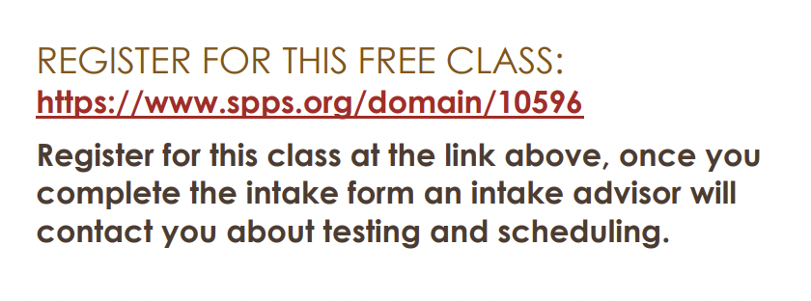
https://www.spps.org/domain/10596

